Slide 1

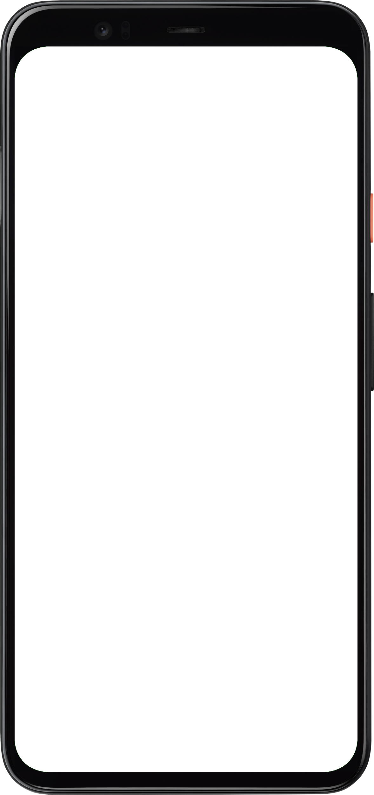
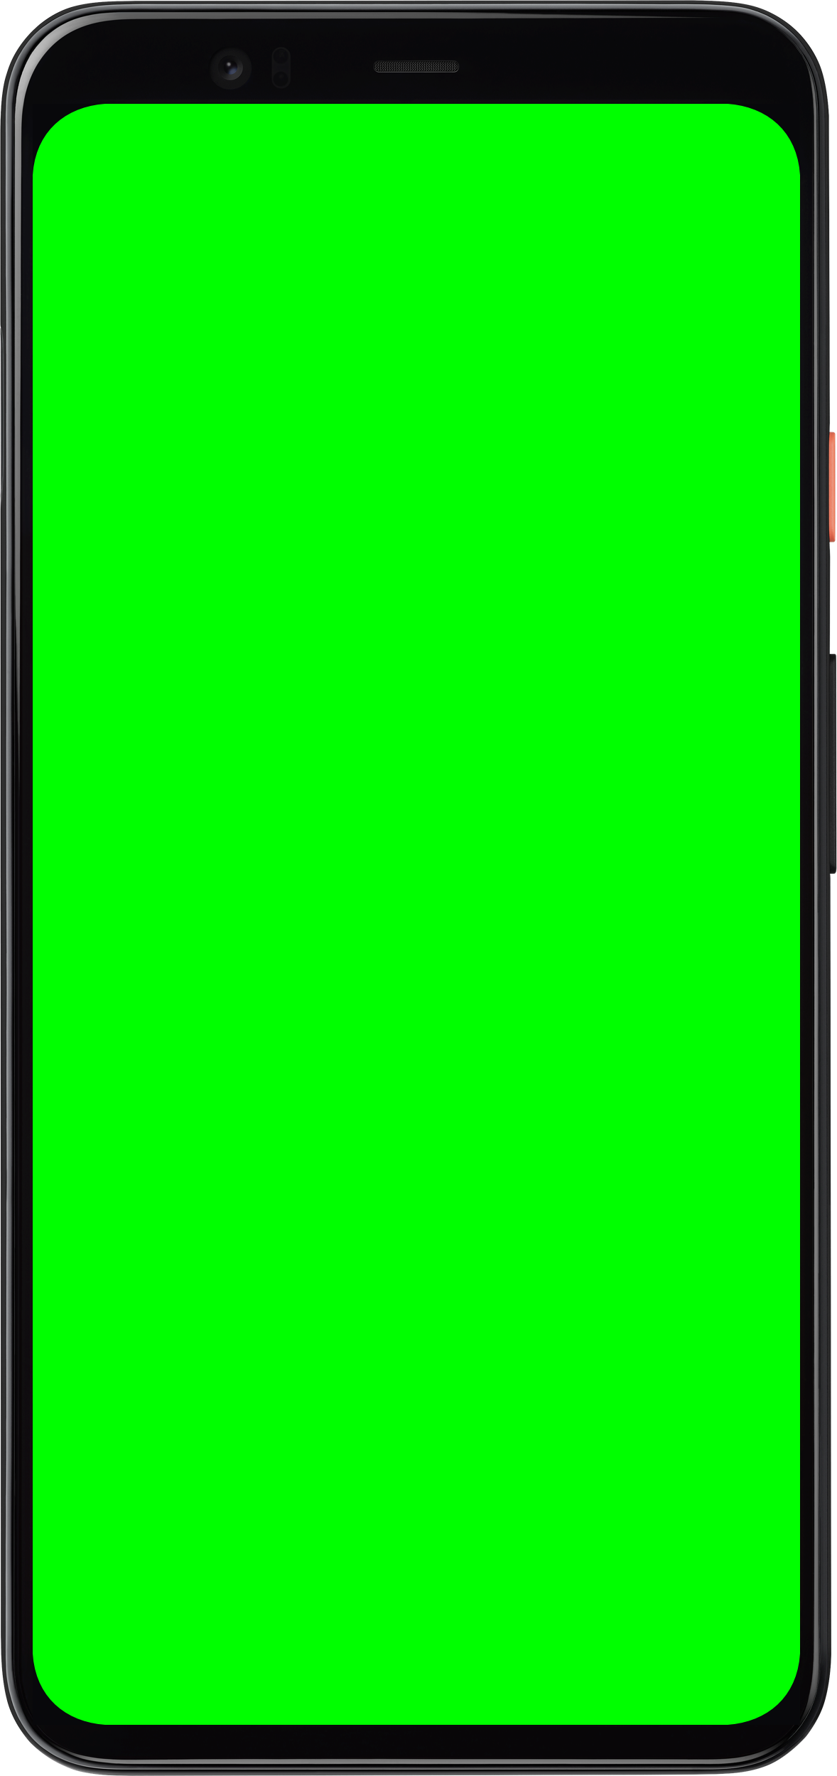




Universal GMS Doze
Universal GMS Doze

Slide 2
Copyright © 2022 <PixelHub>
Permission is hereby granted, free of charge, to any person obtaining a copy of this slides and associated documentation files (the “Slides”), to deal in the Slides without restriction, including without limitation the rights to use, copy, modify, merge, publish, distribute, sublicense, and/or sell copies of the Slides, and to permit persons to whom the Slides is furnished to do so, subject to the following conditions:
The above copyright notice and this permission notice shall be included in all copies or substantial portions of the Slides.
THE SLIDES IS PROVIDED “AS IS”, WITHOUT WARRANTY OF ANY KIND, EXPRESS OR IMPLIED, INCLUDING BUT NOT LIMITED TO THE WARRANTIES OF MERCHANTABILITY, FITNESS FOR A PARTICULAR PURPOSE AND NONINFRINGEMENT. IN NO EVENT SHALL THE AUTHORS OR COPYRIGHT HOLDERS BE LIABLE FOR ANY CLAIM, DAMAGES OR OTHER LIABILITY, WHETHER IN AN ACTION OF CONTRACT, TORT OR OTHERWISE, ARISING FROM, OUT OF OR IN CONNECTION WITH THE SLIDES OR THE USE OR OTHER DEALINGS IN THE SLIDES.

Slide 3
你好

Slide 4

功能
美化

Slide 5
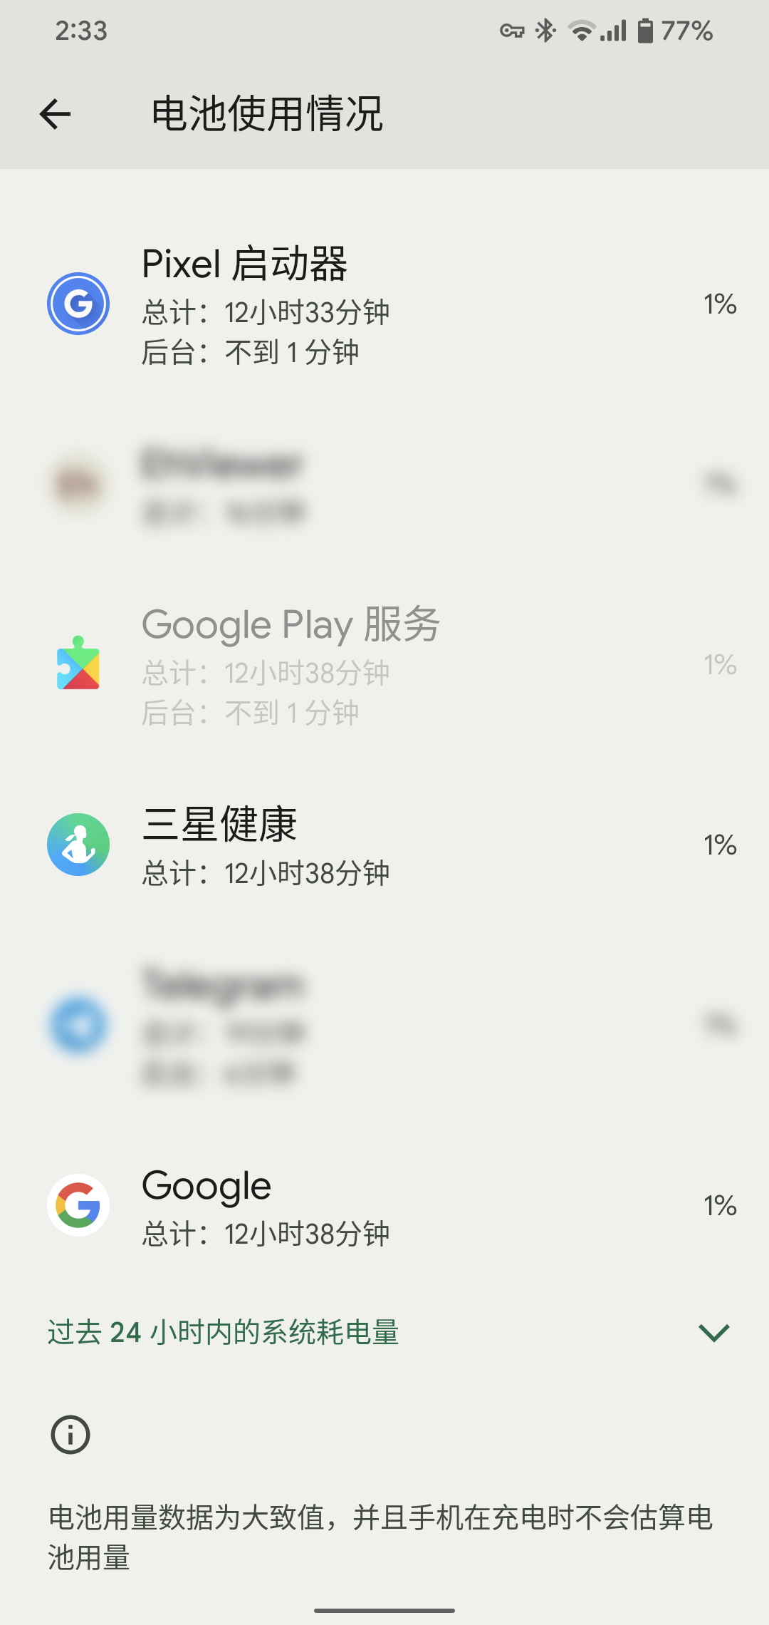
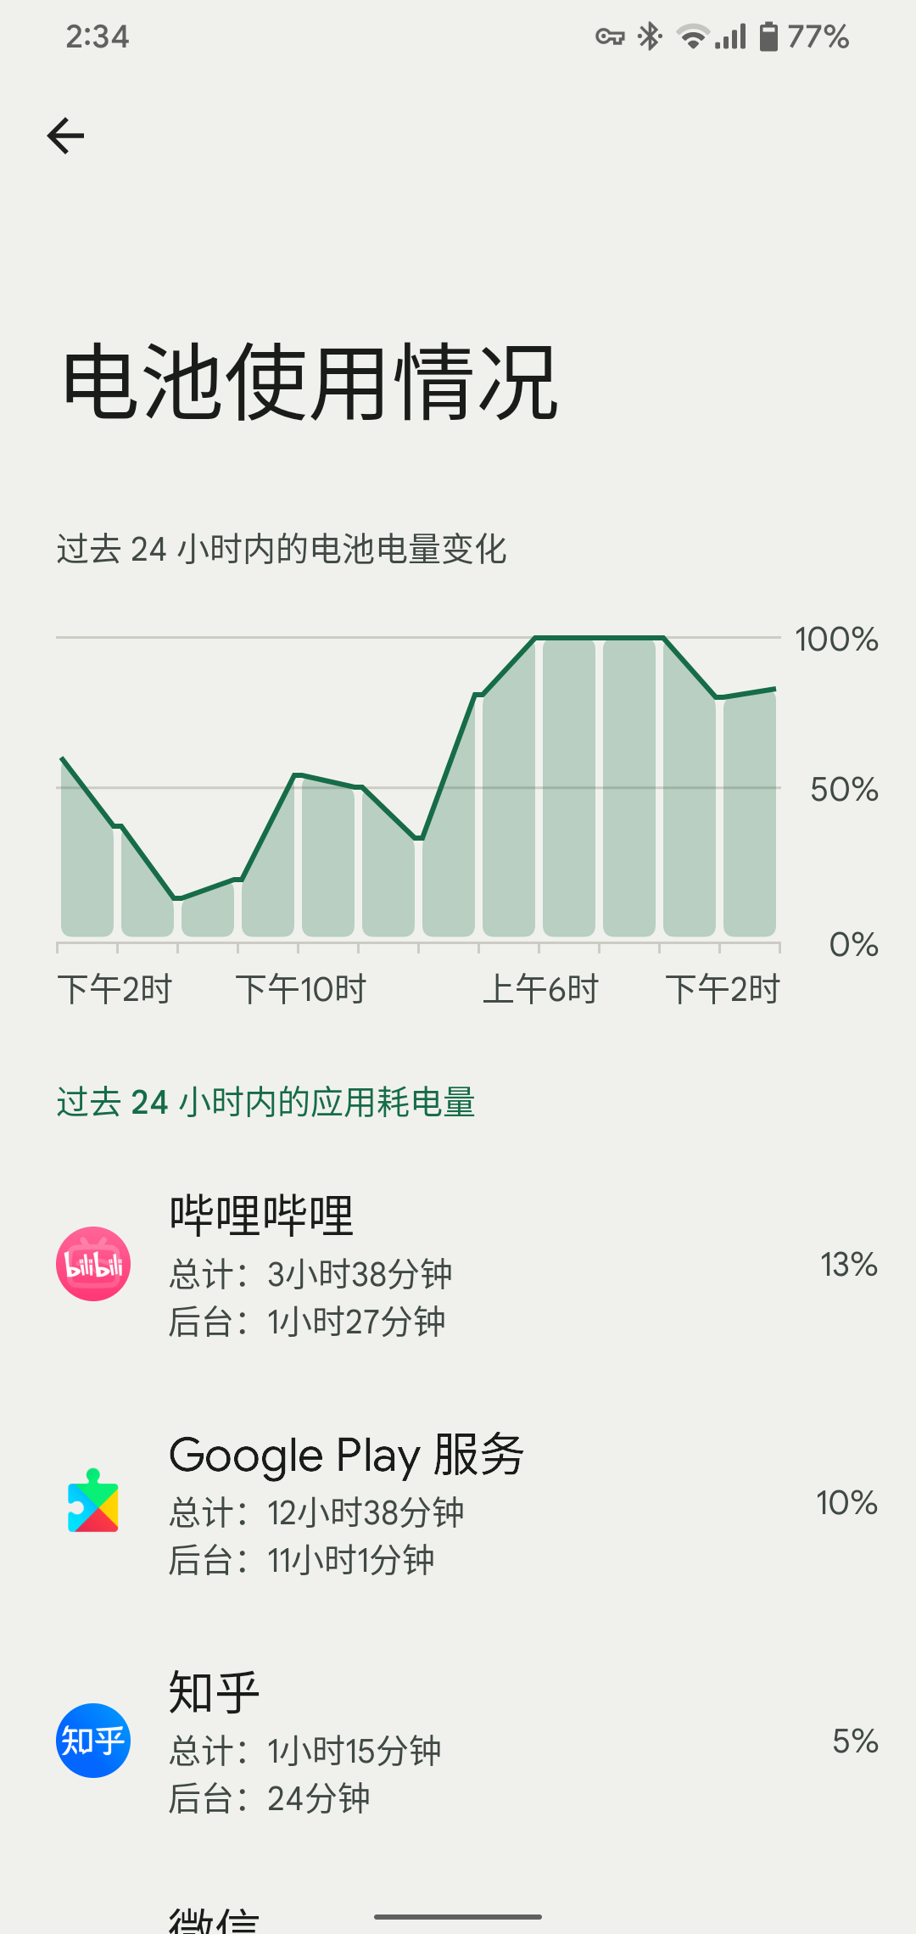
Universal GMS Doze
使用 Universal GMS Doze
使用 Universal GMS Doze
Universal GMS Doze 能够自动休眠谷歌服务，提高设备
的续航能力。
Google Play服务是耗电的元凶
重复唤醒，无法连接
模块自动按需唤醒谷歌服务
减少后台留存撞墙
影响FCM推送的延迟缺陷
通知可能会延后

Slide 6
功能
美化

Slide 7
幻灯片中所有出现的商标均为对应公司的商标或注册商标

